Slide 1
Welcome to Roundtable!

Slide 2
September 11th Show & Sell Distribution
October 30th-31st Show & Sell Returns, Take-Orders, and Prize Orders Deadline
November 20th Take-Order Distribution
www.NCBSA.org/POPCORN

Slide 3
Welcome to Adventure Weekends
Welcome to Adventure Weekend is an opportunity for new Scouting families to experience the adventures of Cub Scouting in one fun-filled weekend!
Spend your day participating in all the outdoor programs found at Camp Norse or Adventure Base Camp including archery, outdoor cooking and some unique activities just for this weekend. Enjoy lunch, dinner, and a campfire program on Saturday as well. Then sleep in a tent under the stars!
Experienced Scouts, Scouters, and staff will be on hand all weekend to ensure you have a wicked awesome time.
Camp Norse: September 18th - 19th
Adventure Base Camp: October 16th - 17th

Slide 4
Scouting Trivia
What are the ten points of the Scout Law as written by Robert Baden-Powell?

Slide 5
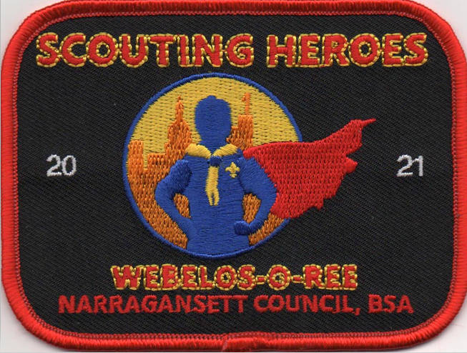
Webelos-O-Ree Camp Yawgoog September 24th – 26th
This event is for WEBELOS Scouts and their adult partner(s) and is designed to introduce them to the many outdoor adventures of Scouting.
This WICKED AWESOME weekend includes patrol method camping and Scout activities.
This event is also for Scouts BSA members participating with their Troop.

Slide 6
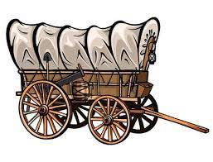
Covered Wagon Derby Camp Norse October 16th
During the course of the day Cubs will go from activity to activity with their own designed "covered wagon" (red fancy radio flyer wagon). Scouts and Parents will work together as a team in various games and Scout skill stations. They will learn along the way and have a WAGON full of of FUN with a PURPOSE!
Scouts participating in the Covered Wagon also have the opportunity to earn the Messenger of Peace award.

Slide 7
Cub Scout Activities
18-19 Sep – Welcome to Adventure Weekend, Camp Norse
24-26 Sep – Webelos-O-Ree, Camp Yawgoog
1-3 Oct – Webelos Weekend Adventure, Camp Norse
16 Oct – Covered Wagon, Camp Norse
16-17 Oct – Welcome to Adventure Weekend, Camp Champlin
11 Dec – Holiday Family Fun Day, Camp Yawgoog
29 Jan – Cub Scout Iditarod, Camp Norse

Slide 8
Scouting for Food
For over 30 years, Scouters have come together to help foodbanks feed the hungry in our communities. To date nearly 10 million pounds of food have been collected through your good turn efforts.
By participating in this Scouting for Food Good Turn, together, we in the Narragansett Council can show our communities and our Scouts that we haven’t forgotten the principles that have made the Boy Scouts of America Strong.
Door Hanger Distribution is October 30, 2021
Food Collection is November 6, 2021

Slide 9
Cachalot 75th Celebration
September 18th 2021
Cachalot Alumni will be hosting a Homecoming event like no other, Cachalot only turns 75 once!
Celebrate our Wall of Fame honorees
Take a historic tour of Cachalot
Take in the sunset over Five Mile Pond
All this and more while enjoying the fellowship of other alumni.

Slide 10
Scouts BSA Activities
18 Sep – Cachalot 75th Celebration, Camp Cachalot
24-26 Sep – Webelos-O-Ree, Camp Yawgoog
1-3 Oct – Operation Be Prepared, Camp Yawgoog
8-10 Oct – Highland Games, Camp Cachalot
13 Nov – Merit Badge Mania, TBA
20 Nov – Fall Camp-O-Ree, Camp Norse
6 Jan – Merit Badge College, TBA

Slide 11
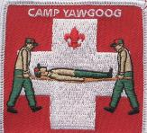
Operation Be Prepared
Join us for the annual “Operation Be Prepared Weekend” hosted by Yawgoog Scout Reservation. This event is geared for leaders who need to be certified and Scouts who need to earn either First Aid, Search and Rescue or Emergency Preparedness Merit Badges.
Earn and learn at the same time. This is your chance to earn badges and spend the weekend with fellow Scouts and Scouters and train together.
October 1st – 3rd

Slide 12
HIGHLAND GAMES
October 8th – 10th 2021
Camp Cachalot
Come test your skills and work as a team to compete in the 2021 Highland Games!
Scouts will compete in unique contests of skill and strength including caber toss, tomahawk throws and bagpipe construction. Register as a unit and prove your unit is the best is all the HIGHLAND!

Slide 13
Training Opportunities
18-19 Sep – Leave No Trace Trainer Course, Camp Yawgoog
1-3 Oct– Wilderness First Aid, Camp Aquapaug
10 Oct – Charter Organization Representative Training, Virtual
15-17 Oct– Introduction to Outdoor Leadership Skills, Camp Yawgoog [Scouts BSA]
16-17 Oct– Basic Adult Leader Outdoor Orientation, Camp Yawgoog [Cub Scouts]
6 Nov – Venture Advisor Training, Camp Champlin

Slide 14
Scouting Trivia Answer
THE SCOUT LAW
A Scout’s honour is to be trusted.
A Scout is loyal.
A Scout’s duty is to be useful and to help others.
A Scout is a friend to all and a brother to every other Scout.
A Scout is courteous.
A Scout is a friend to animals.
A Scout obeys orders of his parents, Patrol Leader or Scoutmaster without question.
A Scout smiles and whistles under all difficulties.
A Scout is thrifty.
A Scout is clean in thought, word and deed.

Slide 15
BALOO Training Camp Norse October 16th – 17th
Are you up to date on your training?
Does your Pack want to add camping outdoors to their growing list of Scouting events?
This course is designed as an introduction to Cub Scout outdoor program for leaders interested in adding a camping component to their pack activities, Completion of this course is mandatory for a minimum of one adult on a Pack overnighter.

Slide 16
Leave No Trace Trainer Course
The Leave No Trace course is for everyone age 14 & older who will teach Leave No Trace to others. LNT is integrated into every Scouting Program, every Pack, Troop, Team, Crew and Ship should have a LNT Trainer.
Participants learn LNT principles, skills and ethics through a combination of presentation, discussion and hands-on activities.
Camp Yawgoog– September 18th - 19th

Slide 17
Camp Aquapaug: October 1st – 3rd Camp Norse: November 5th – 7th
American Red Cross Wilderness & Remote First Aid is a 16 hour course designed to teach individuals how to deal with emergency situations by using first aid skills in a delayed help environment.
Earn your Basic 1st-Aid/CPR/AED certificate and your Wilderness & Remote 1st-Aid certificate on this course.
For Scouts 14 years of age or older and Scouters.

Slide 18
Let’s be friends! #wickedawesomescouts
Facebook.com/ncbsa
Instagram.com/ncbsa
Linkedin.com/company/ncbsa
Youtube.com/ncbsa
Twitter.com/ncbsa

Slide 19
Thank you for your leadership in Scouting!

